Slide 1

GitHub Copilot Hackathon
Team Name - LLM Professors
Team Leader Name - Salil Gautam
Team Leader Email Address - salil.gtm@gmail.com

Slide 2


Weather Forecasting Tool
A command-line tool that accepts a city's name and returns the current weather forecast. It leverages OpenWeatherMapAPI to fetch weather data along with a friendly spelling corrector.
The project is entirely built with the help of GitHub CoPilot which majorly helped in:
Parsing the Data
Building the command-line tool
Error handling
Spell Checking to correct city names

Slide 3
Use Cases
This tool is a showcase to understand how Github Copilot can help in faster software development. These are our learnings as a team by utilizing it during the Hackathon:
Syntax and API Suggestions: CoPilot provided accurate syntax suggestions and recommended the right Python APIs, ensuring our code was error-free and efficient.
Improved Productivity: CoPilot automated repetitive coding tasks, handled imports, and suggested code refactorings, allowing us to focus on the core logic of our CLI tool and boosting our overall productivity.
Error Prevention: CoPilot acted as a vigilant assistant, helping us catch potential errors such as missing parentheses or incorrect variable assignments by offering real-time suggestions and corrections.
Rapid Prototyping: With CoPilot's assistance, we quickly prototyped and iterated on our CLI tool, leveraging its relevant code snippets and suggestions to expedite the development process.
Collaboration: CoPilot ensured coding style consistency among our team members by generating code that aligned with our project's conventions, fostering effective collaboration and communication.

Slide 4
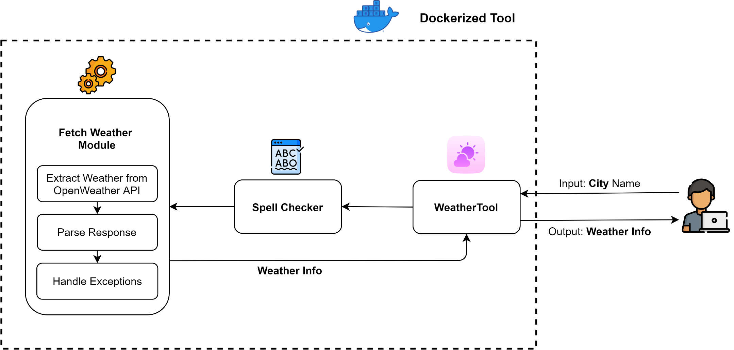
Proposed Solution
Our solution is entirely dockerized so it can be put on any pod and should be up and ready to serve.

Slide 5





Technology/Tool Stack Used:

Slide 6
Usage of Github Copilot
Github Copilot accelerated our development by using the following approaches:
Parsing the Data:
GitHub CoPilot greatly assisted us in parsing the weather data obtained from the OpenWeatherMapAPI. It provided code suggestions and snippets for efficiently extracting and organizing the relevant information.
Building the Command-Line Tool:
CoPilot proved invaluable in constructing the command-line interface (CLI) for our weather forecast tool. It generated code snippets that helped handle user inputs, display weather information, and format the output effectively.
Error Handling:
CoPilot significantly contributed to the error handling mechanism of our CLI tool. By suggesting error-checking code and exception handling blocks, it ensured a robust user experience, gracefully handling unexpected situations or erroneous inputs.
Spell Checking to Correct City Names:
With CoPilot's assistance, we integrated a spell-checking feature to verify and correct city names entered by users. By leveraging CoPilot's code suggestions, we were able to implement an accurate spell-checking mechanism, enhancing the usability of our tool.

Slide 7
Source code in zip file / Github link :
https://github.com/G-Slient/weather-cli

Slide 8
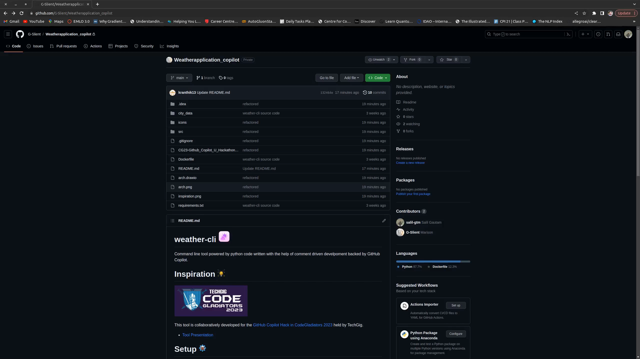
Demo

Slide 9
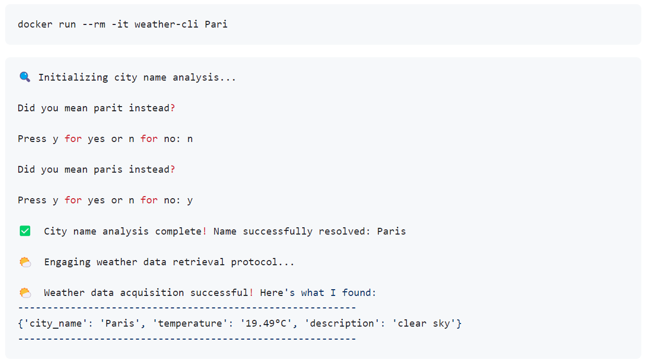
Tool Demo (Screenshot)

Slide 10
THANK YOU

